Slide 1


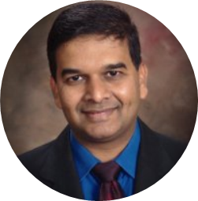
Dr. Anish S. Shah, MD

Slide 2
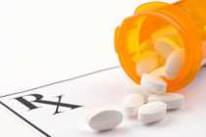
The Opioid Epidemic
Notes:
Late 1990s, pharmaceutical companies to doctors: opiates not addictive
Opiate prescriptions went up
Misuse increased – both prescribed and not
Realization: opiods could be highly addictive
Pain was considered as 5th Vital Signs. Provider were told by Medical Boards to treat pain adequately. There was a huge investment and push toward research and development of various opiates. Off label use was widely utilized. Even one study suggested now that more than 5 days use of opiate can lead to abuse and dependence.

Slide 3
The Opioid Epidemic - 2018
2,311 Deaths related to any Opioid Overdose
743 Deaths related to Fentanyl Overdose
8,832 ED visits related to any Opioid Overdose
19,808,224
Opioid prescriptions
Notes:
Pain was considered as 5th Vital Signs. Provider were told by Medical Boards to treat pain adequately. There was a huge investment and push toward research and development of various opiates. Off label use was widely utilized. Even one study suggested now that more than 5 days use of opiate can lead to abuse and dependence.

Slide 4
2018
MISUSE: 2 Million People
DEATHS:
130+ per day: OVERDOSES
47,600 OVERDOSES
HEROIN:
81,000:first use of Heroin
886,000 uses
15,482 deaths

Slide 5
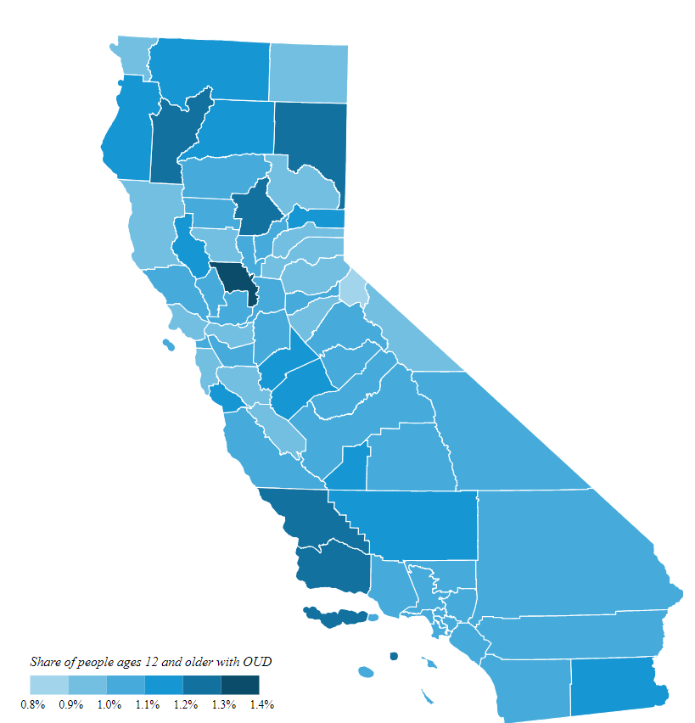
The Opioid Epidemic: California
HUMBOLDT
TRINITY
LASSEN
MENDOCINO
LAKE
ALPINE
YOLO
SONOMA
SANTA BARBARA
SAN LUIS OBISPO

Slide 6
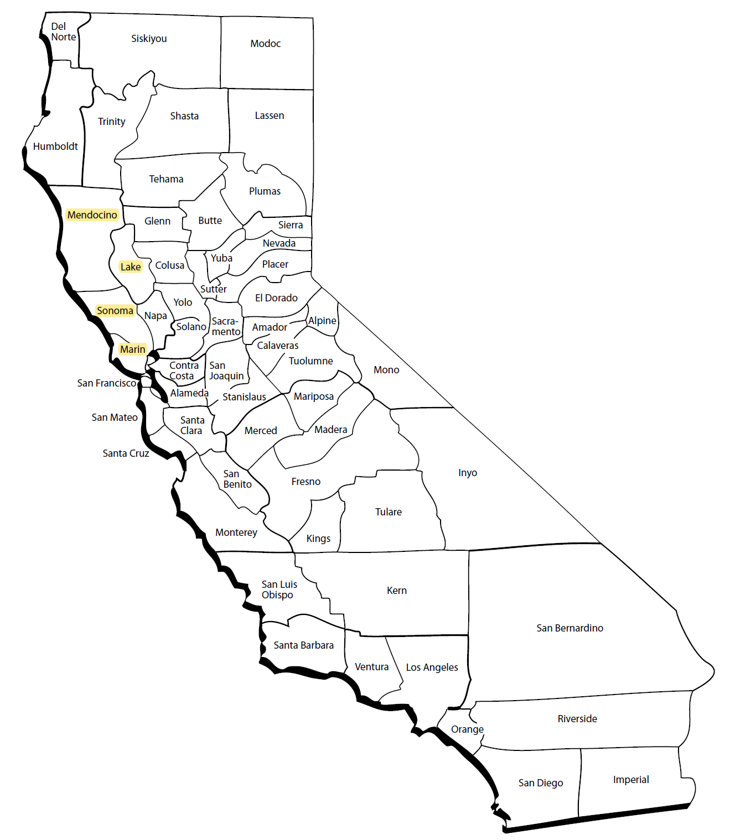
The Opioid Epidemic: Northern California
Opioid death rates greater than entire state at 11 per 100,000
Lake County #5 in U.S. in number of opioid deaths
Mendocino County: 2 deaths/month from opioid overdose
Sonoma County: a resident dies of opioid overdose deaths every 8 days

Slide 7

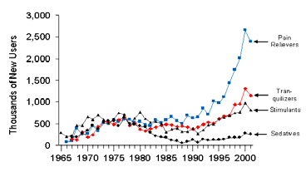
New Nonmedical
Users of Psychotherapeutics: 1965–2001
Pain Relievers
Tranquilizers
Stimulants
Sedatives
Notes:
Over the years if you see how the non medical use has grown. As you can see Pain Medication far exceeds than all other substances when it comes to NON MEDICAL USE.

Slide 8

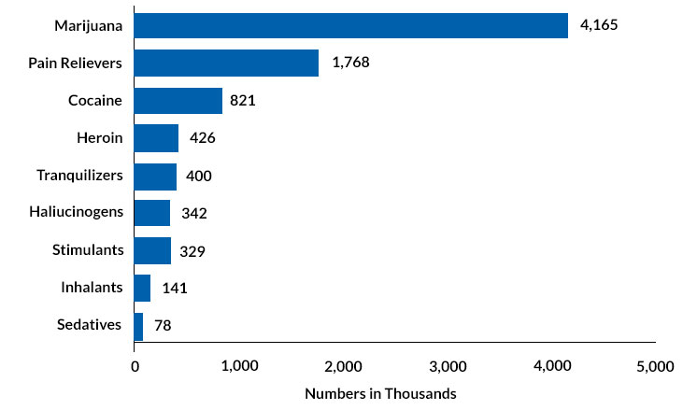
SUBSTANCE USE DISORDERS IN US
8
Notes:
National Survey of Drug Use and Heath. Ss you can see Cannabis by definition is no 1 followed by Pain pills. You can see Sedatives are last here.

Slide 9
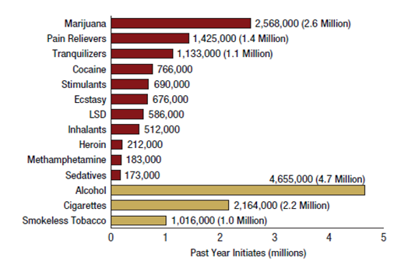
NEW USERS IN US, 2014
9

Slide 10
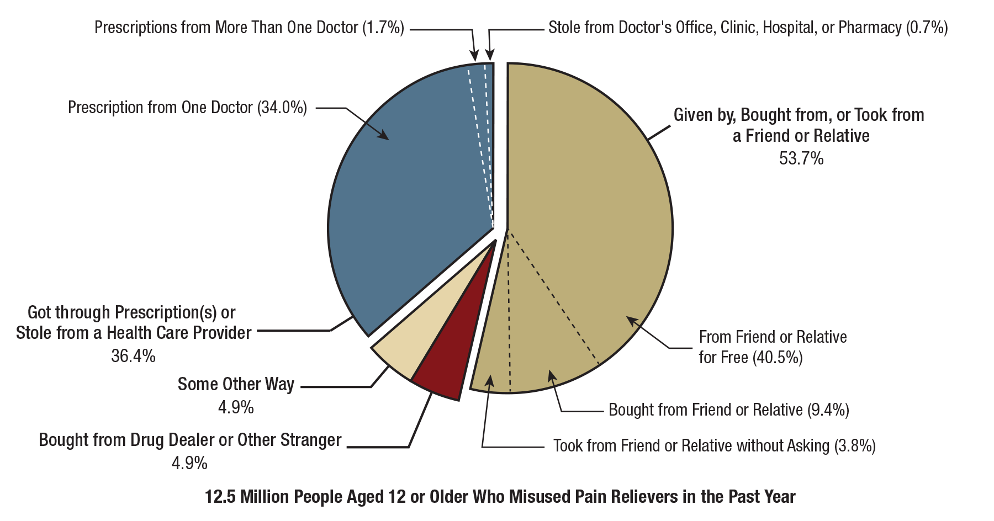
Misused Pain RELIEVERS: SOURCES
10
Notes:
Pain Pills given by Friend or relative is 53.7 and prescription from doctor is 36.4. How this co dependency is causing issues.

Slide 11
Misused Pain RELIEVERS: SOURCES
From HEALTH CARE PROVIDER(s): 36.4%
Free from FRIEND/RELATIVE: 53.7%
Bought from Dealer or Stranger: 4.9%
Some other way: 4.9%
11
Notes:
Pain Pills given by Friend or relative is 53.7 and prescription from doctor is 36.4. How this co dependency is causing issues.

Slide 12
Substance use disorder symptoms
Excessive amounts used
Excessive time spent using/obtaining
Hazardous use despite health problems
  Missed obligations
  Interference with activities
  Personal problems
Craving or urges to use
Unsuccessful attempts to cut down
12

Slide 13
Medication-Assisted Treatment
Medications used in combination with counseling and behavioral therapies.
effective in the treatment of opioid use disorders (OUD)
can help some people to sustain recovery.

Slide 14
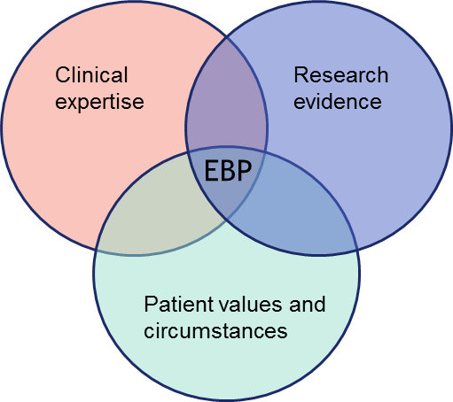
Evidence-Based Treatment
Notes:
An evidence-based practice (EBP) is any practice that relies on scientific evidence for guidance and decision-making. Practices that are not evidence-based may rely on tradition, intuition, or other unproven methods.

Slide 15
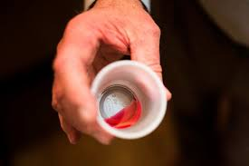
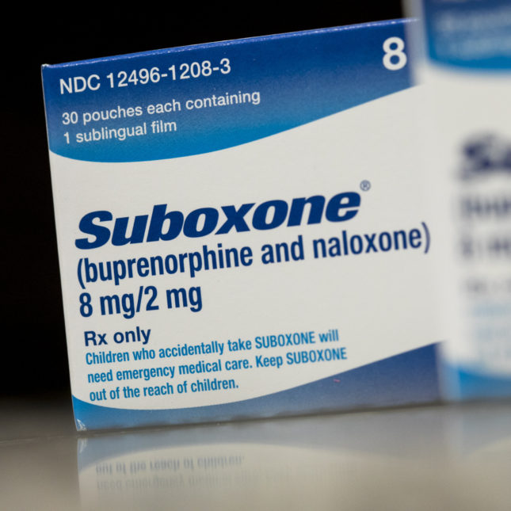
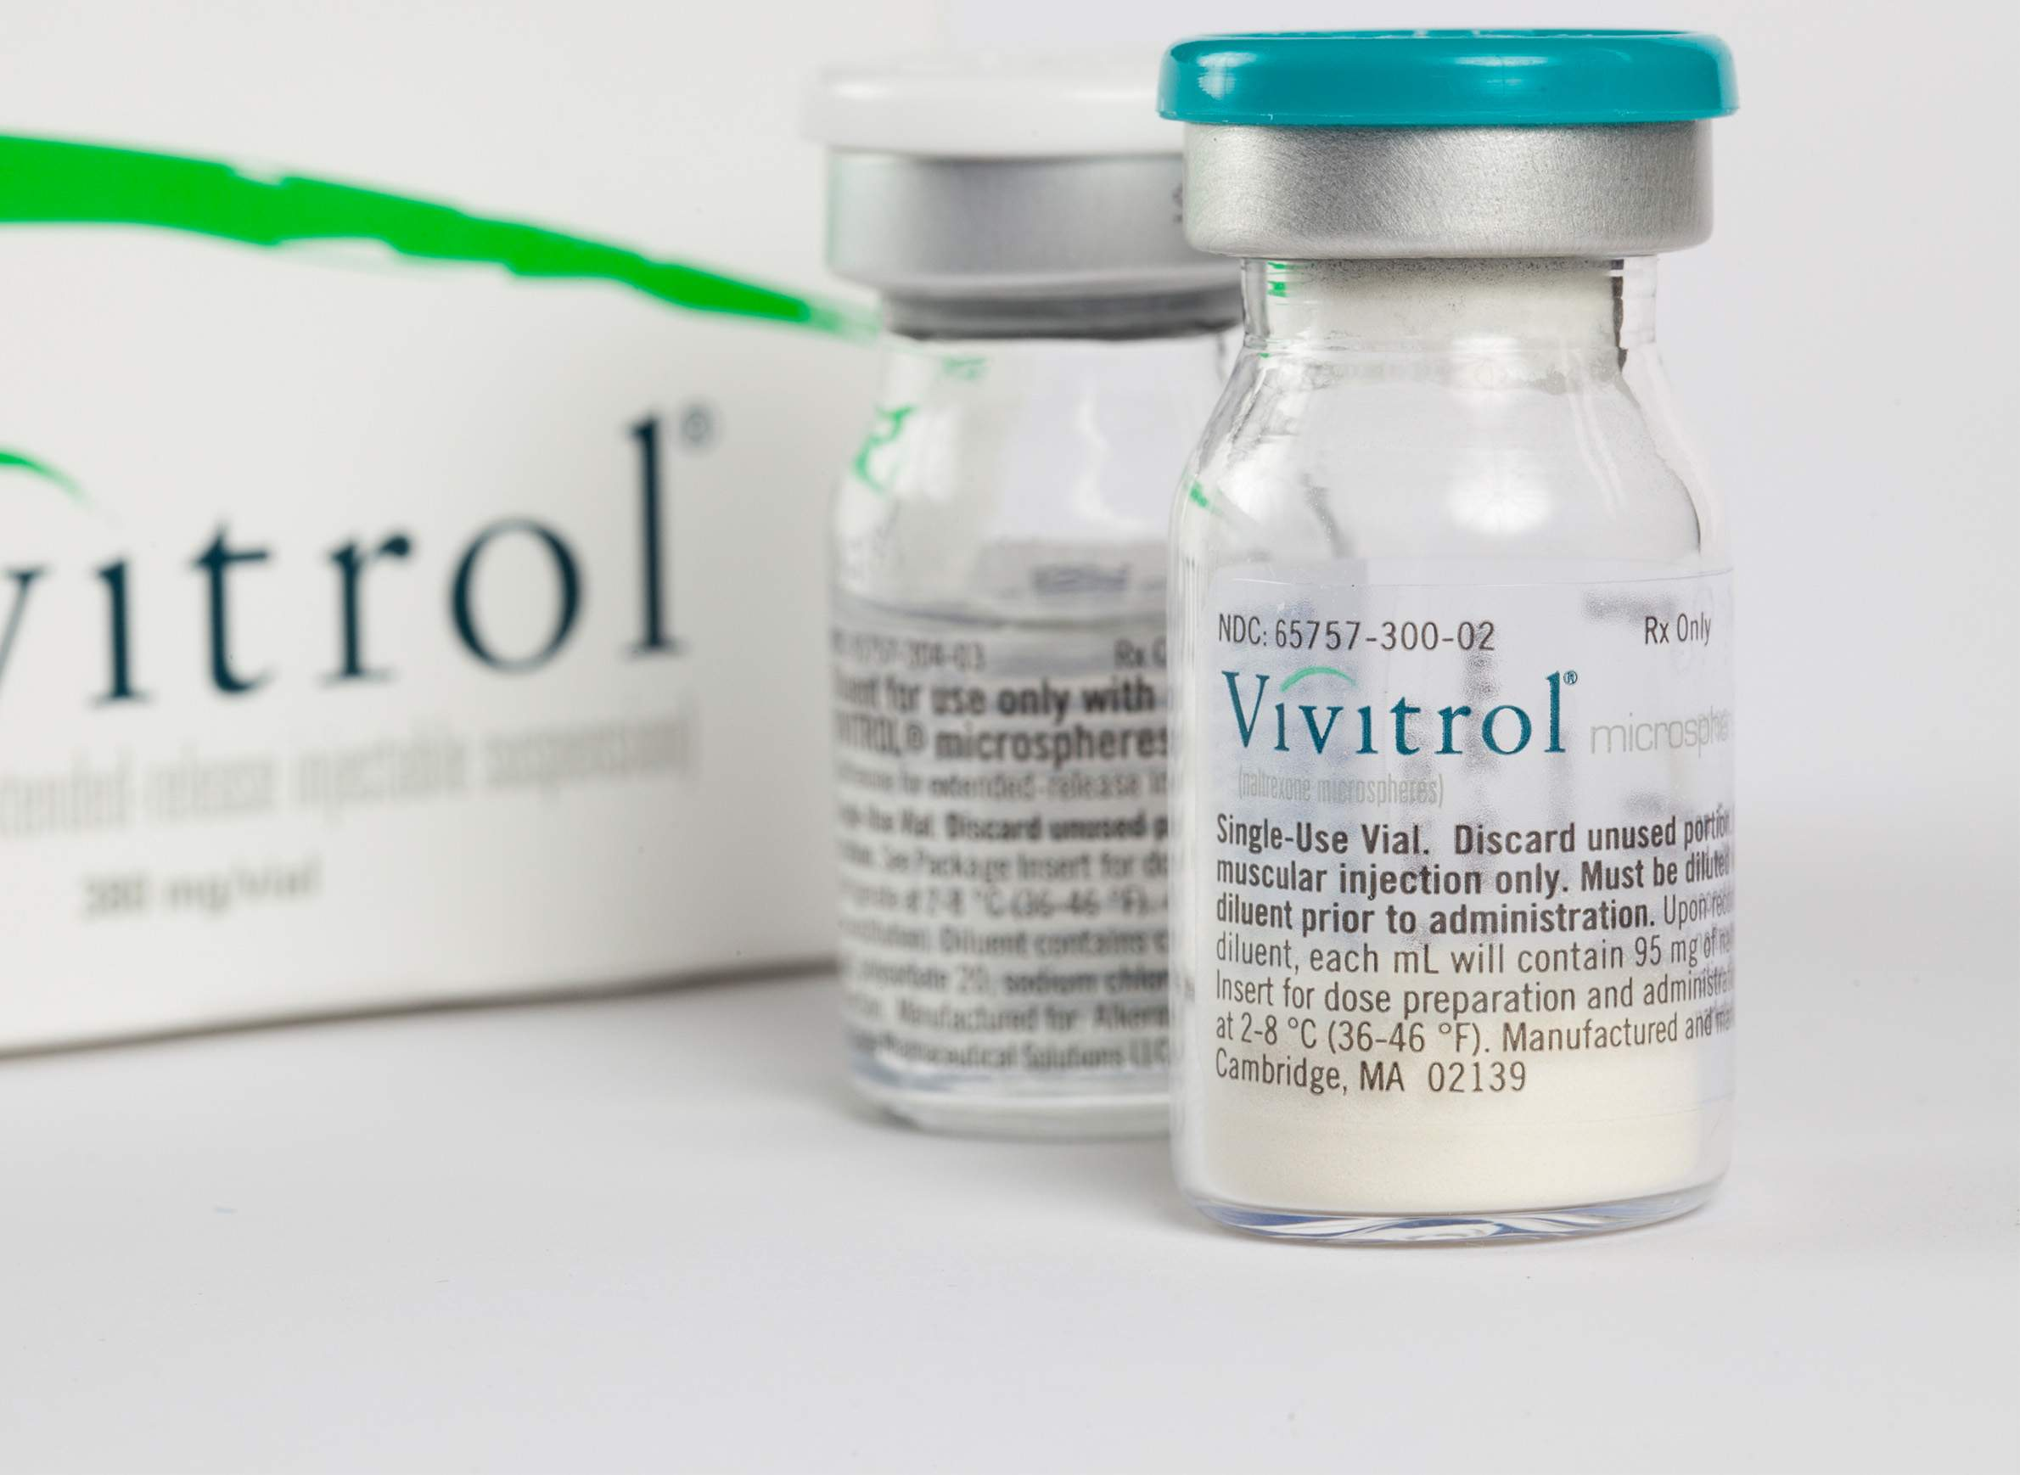
FDA Approved Medication
Safe, combined with counseling and psychosocial support
Buprenorphine
Naltrexone
Methadone
https://www.fda.gov/drugs/information-drug-class/information-about-medication-assisted-treatment-mat

Slide 16
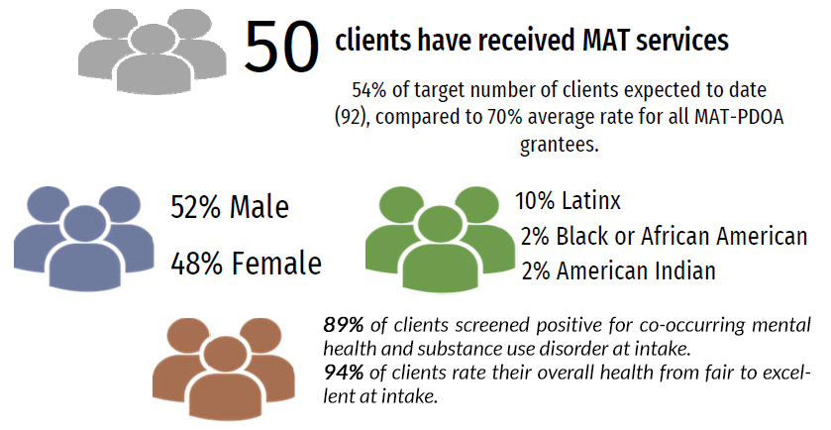
Project Hope Data Summary
September 30, 2018 - January 31, 2020

Slide 17
Project Hope Data Summary
September 30, 2018 - January 31, 2020
100% of patients have completed OUD diagnostic criteria screening to determine MAT eligibility.
84% of patients are still active or have remained in treatment for at least 90 days via use of Motivational Interviewing, relapse prevention education, and recovery support services. GOAL: 60%
68% of patients ABSTAINED FROM ALCOHOL/ILLICIT DRUGS at 3 month follow up
76% of patients ABSTAINED FROM ALCOHOL/ILLICIT DRUGS at 6 month follow up
100% of patients had no past 30 day arrests at 3 month follow up

